Slide 1
Quantum computing

Slide 2
Introduction to Computing (~ Classical)
Is currently done on your laptop today
Numbers as we commonly use them are in decimal (base 10) format. Computers represent them in binary (base 2).
Each computational operation is done one step at a time.
Decimal vs. Binary
Decimal Representation
10³ | 10² | 10¹ | 10⁰
1000 | 100 | 10 | 1
The number 14: 1 in the 10’s and 4 in the 1’s

Slide 3
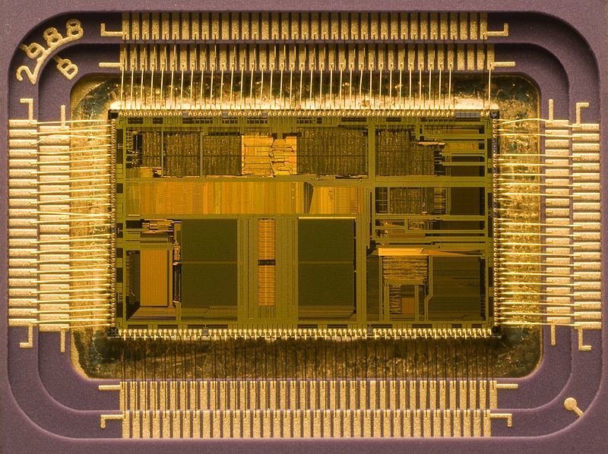
How do we do this?
How do we represent this in another base? Add up all the digits to get the same value.
Binary Representation
2³ | 2² | 2¹ | 2⁰
8 | 4 | 2 | 1
14 = 8+4+2 → 1110
BITS!
Shown is an Intel processor capable of performing 1,000,000,000 (1 billion) mathematical operations per second!
It is composed of ~500,000,000 individual Transistors! (Transisitors have no moving parts and are turned on and off by electrical signals)
The typical size of a transistor in the picture is about 0.04mm

Slide 4
What is a computation? (Let’s revise)
Generation of an output number (string of bits) based on an
input number.
…101101001…
“Black Box” or
Computer
Output
Input
…000111010…
How does the computer achieve this?

Slide 5
Digital electronics
Physical bit - electrical voltage
+5V = 1
0V = 0
Single bit operation
0
1
1
0
NOT gate

Slide 6
Two bit operations
0
0
1
1
0
1
0
1
0
0
0
1
AND gate
0
0
1
1
0
1
0
1
0
1
1
1
OR gate

Slide 7
Two bit operations
0
0
1
1
0
1
0
1
1
1
1
0
NAND gate
Not all the gates are needed
A small set of gates (e.g. NAND, NOT) is universal in that any logical operation can be made from them.

Slide 8
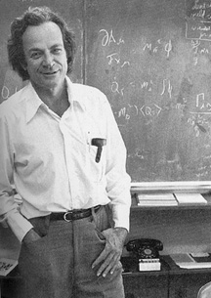
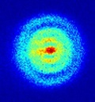
“Simulating Physics with Computers”
Richard Feynman – Keynote Talk, 1st Conference on Physics and Computation, MIT, 1981
“There is plenty of room at the bottom”
Nanotechnology in computer: Nano-computing
Computers in the 20th century showed a miniaturization of microprocessors and are in a process of being nano-metre scale.
1 nm= 2 times the size of hydrogen atom
5nm= 10times the dimension of one hydrogen atom
Quantum effects!!

Slide 9
Introduction
What is a quantum computer?
A quantum computer is a machine that performs calculations based on the laws of quantum mechanics, which is the behavior of particles at the sub-atomic level.
1982 - Feynman proposed the idea of creating machines based on the laws of quantum mechanics instead of the laws of classical physics.
1985 - David Deutsch developed the quantum turing machine, showing that quantum circuits are universal.
1994 - Peter Shor came up with a quantum algorithm to factor very large numbers in polynomial time.
1997 - Lov Grover develops a quantum search algorithm with O(√N) complexity

Slide 10
Classical Physics
Predictable outcomes!
Variables are continuous
Take on finite known values
Always has a known state
Binary numbers in the form of switches that are on or off!
Quantum Physics
Violate classical laws at a small scale (~h, Plank’s Constant)
Variables are discrete |0> or |1>
Can be in a superposition of values (representing all states simultaneously)
State is indeterminate until measured.

Slide 11
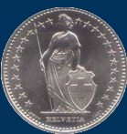
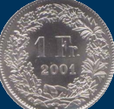
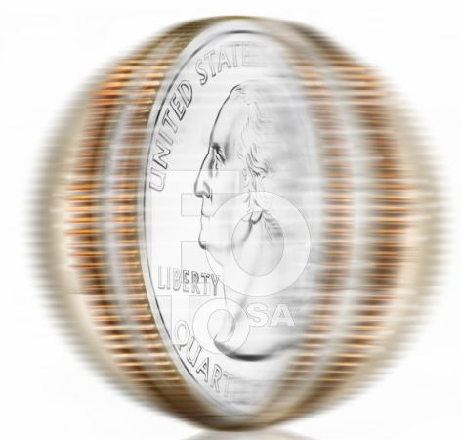
conventional memory:
Tossed coin
quantum memory:
Spinning coin
Result is either 0
or
1
Result is 0
and
1
(both)
sequence of 11 bits:
sequence of 11 quantum bits:
11111011011
(0+1)(0+1)(0+1)(0+1)(0+1)(1+0)
(0+1)(0+1)(1+0)(0+1)(0+1)
stores only one number:
2011
stores all numbers from 1 to
2048 (All possibilities !!)

Slide 12
Classical bits (Cbits)
The two states of a Classical bit by a pair of orthonormal vectors denoted by the symbols|0> and |1>.
It is convenient to represent the four states of two Cbits
|0>|0>, |0>|1>, |1>|0> and |1>|1> or more readably |00> |01> |10> |11>
Most compactly of all, using the decimal representation of 2bit number represented by the pair of C-bits
|0>₂, |1>₂, |2>₂, |3>₂
One represents the states of ‘n’ as the 2^{n} orthonormal vectors in 2^{n} dimensions.
Thus for example |19>₆ = |010011>= |0>|1>|0>|0> |1> |1>

Slide 13
Quantum bits
A Quantum Bit or a Qubit, is the smallest unit of quantum information, analogous to the bit, in classical computers.
In general state of a single Qubit is a superposition of the two classical basis states
Where the amplitudes α and β are complex numbers constrained
only by the normalization condition
The general state of n Qubits has the form

Slide 14
With complex amplitudes constrained only by the normalization condition
Most general possible state of two Qubit has the form

Slide 15
Information: 1 Bit Example (Coin tossing experiment)
Classical Information:
A bit is in state 0 or state 1
Classical Information with Uncertainty
State (p₀, p₁)
Quantum Information
State is simultaneously both 0(tail) and 1 (head)
State is (α₀, α₁) where α₀, α₁ are complex.
state1=|1>
state2=|0>
state1=|1>
with prob p₀
state1=|0>
with prob p₁
α₀
+
α₁

Slide 16
Information: n(=3) Bit Example
state1=|000>, p₀₀₀
Classical Information:
State of n bits specified by a string x in {0,1}^{n}
Classical Information with Uncertainty
State described by probability distribution over 2^{n} possibilities
(p₀, p₁, …., p ₂^{n}₋₁)
Quantum Information
State is a superposition over 2^{n} possibilities
(α₀, α₁,.., α ₂^{n}₋₁), where α is complex
state1=|001>, p₀₀₁
state1=|010>, p₀₁₀
state1=|011>, p₀₁₁
state1=|100>, p₁₀₀
state1=|101>, p₁₀₁
state1=|110>, p₁₁₀
state1=|111>, p₁₁₁

Slide 17
α₀₀₀
Quantum Information
State is a superposition over 2^{n} possibilities
(α₀, α₁, ...α₂^{n}₋₁), where α is complex
+ α₀₀₁
+ α₀₁₀
+ α₀₁₁
+ α₁₀₀
+ α₁₀₁
+ α₁₁₀
+ α₁₁₁

Slide 18
A ‘bit’ is the basic unit of classical information, but the term is also used to refer to an elementary classical system that can be in one of two states.
For example, a fair coin, is a bit, if the coin lands heads or tails when tossed and not any other feature of the coin, such as its weight or its size.
A qubit can ‘somehow’ be both at the same time are simply confused.
But, unlike a classical bit, a qubit is associated with an infinite set of noncommuting two-valued observables that can’t all have definite values simultaneously.

Slide 19
Quantum Measurement
State of n qubits (α₀,…, α₂^{n}₋₁)
If all n qubits are examined:
Outcome is
010 with probability |α₀₁₀|².
The measurement causes the state of the system to change:
The state “collapses” to 010

Slide 20
Single Qubit measurement
Measurement of a quantum state changes the state.
If a state |v>=a|u_{ǁ}>+b|u⊥> is measured as |u>, then the state |v>, changes to |u_{ǁ}>.
A second measurement with respect to the same basis will return |u_{ǁ}>, with probability 1.
Thus, unless the original state happens to be one of the basis states, a single measurement will change that state, making it impossible to determine the original state from any sequence of measurements.

Slide 21
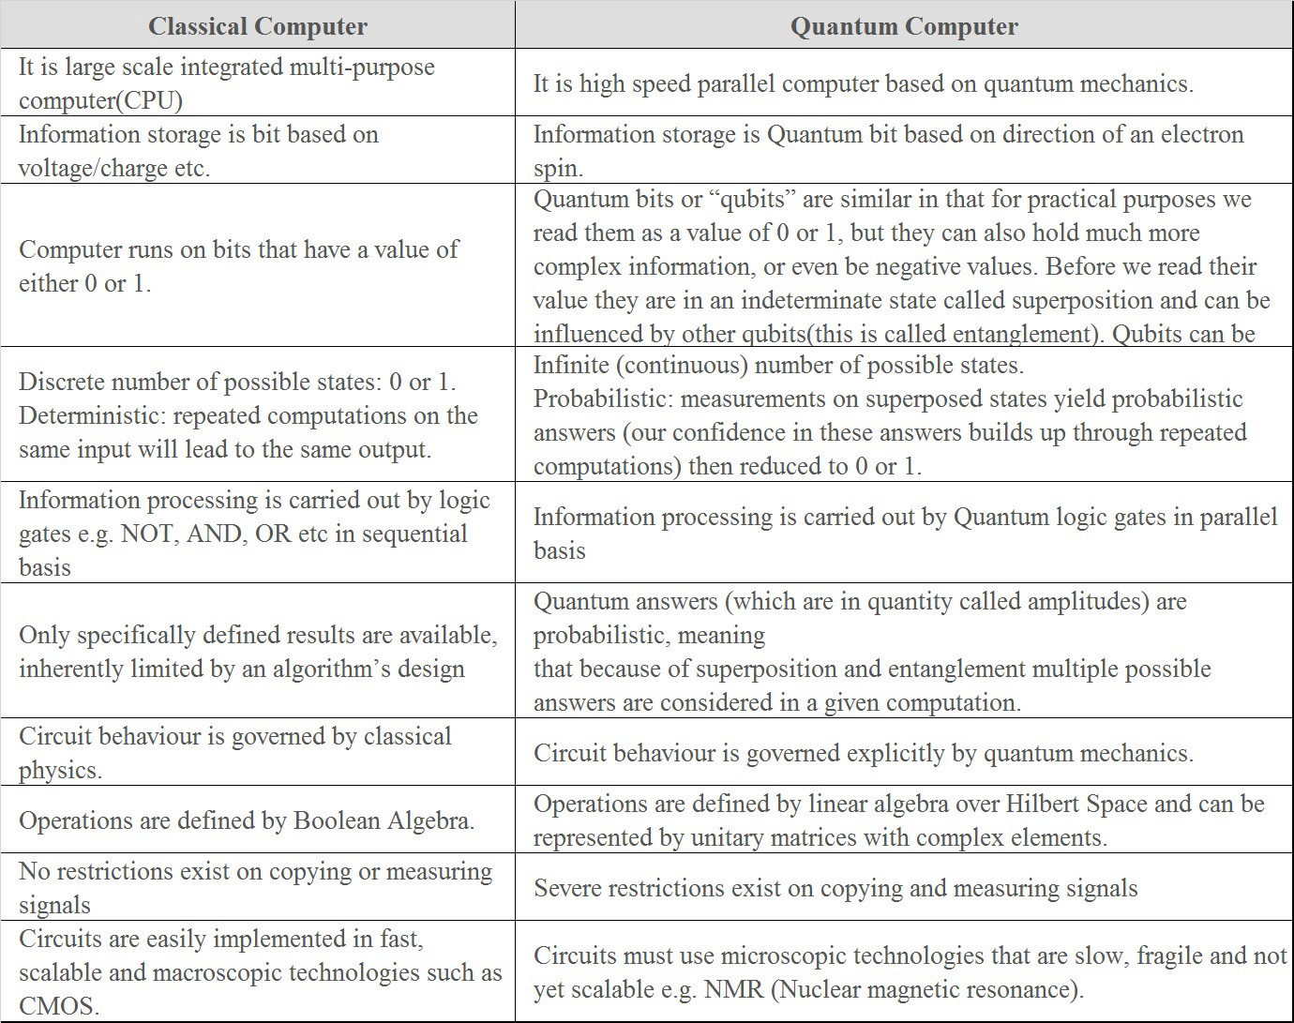

Slide 22
Implementations of a “Qubit”
Polarization of a photon.
Spin orientation of an electron
Energy level of an atom
NMR, Ion traps,…

Slide 23
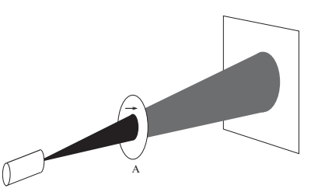
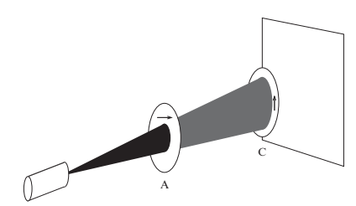
Photon polarization experiment (using-unpolarized light)
case1
screen
Horizontal polarizer ‘A’
Single polaroid attenuates
unpolarized by 50 percent
source of un-polarized light
case2
Two orthogonal polaroid
block all photons

Slide 24
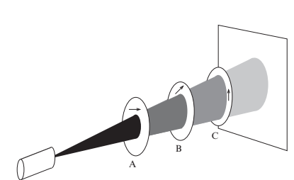
case3
Inserting a third polaroid
allows some photons to pass
How do we understand these results?
Malu’s law !
What about, if source is very dim !! (with very few photons!!)
Rules of Quantum Physics!!!
Quantum Mechanics
Represent the light polarization by a unit vector: a vector of length ‘1’,
pointing appropriate direction.
Example: horizontally polarized light
vertically polarized light
symbol:
|0⟩
symbol:
|1⟩
H
V

Slide 25
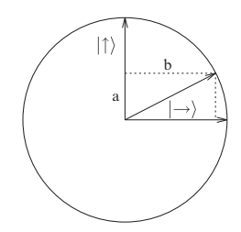
Any arbitrary polarization can be written as a linear combination two basis vectors,
and
by
State superposition of horizontal and
vertical polarization constitute a Qubit
Probability that a photon passes through the polaroid is the square
of the magnitude of the amplitude of its polarization in the direction of
the polaroid’s preferred axis.
When a photon with polarization, meets a polaroid
with preferred axis ,the photon will get through with probability
and will be absorbed with probability
is a unit vector representing polarization
of 45 degrees.

Slide 26
|1>
|0>

Slide 27
Horizontal
Vertical
Diagonal up
Diagonal down
Left circular
Right circular
Thus for light polarization, Diagonal up, diagonal down, Left circular
and right circular constitute an example of Qubit.

Slide 28
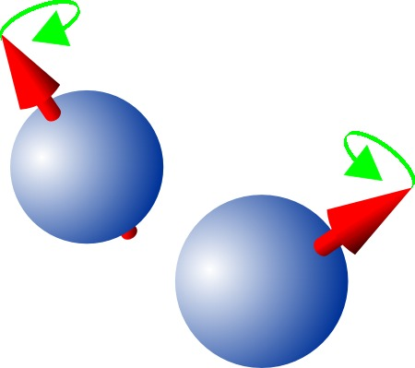
Qubits from Electron spin

Slide 29
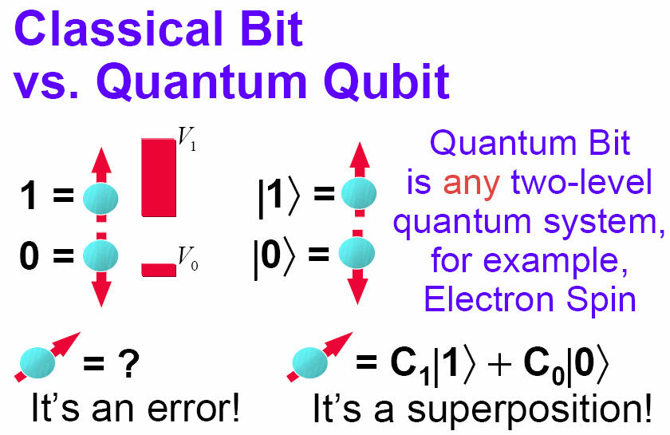
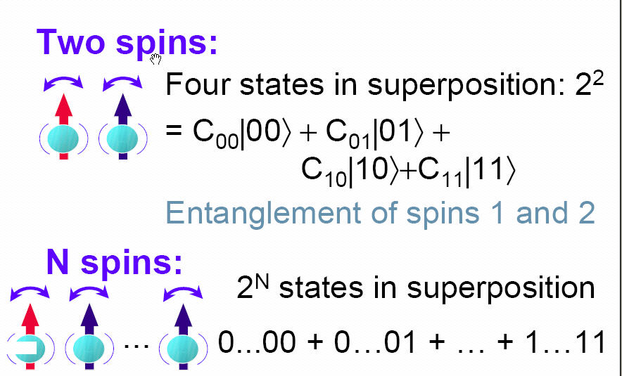
Qubits from electron spin
Classical Bits
Quantum bits: Superposition state
spin up
spin down
It’s a superposition!
It’s an error!

Slide 30
When you measure the spin, it can be in spin up or spin down state. But before you measure It, it can be in a quantum super position state; where these coefficients C₁&C₂ indicate the relative probability of finding the electron in one state or other.

